Slide 1


SHINING STAR OUTSOURCE
SERVICES PVT.LTD.
A LEADING INTEGRATED SERVICES PROVIDER

Slide 2


About Us
Team “SSOS” is backed by a team of enthusiastic & highly experienced professionals in the field of “Facility Management Services”. Our fleet of proficient staff is recognized for completing the assignments within the given timeline.
We offer World Class Facility Management Services for Organizations at competitive cost.
Our clients are highly satisfied with our Services. We provide services for Corporate, Hotels, Educational institutions, Hospitals, Manufacturing Plants & Malls.
We possess the capability to manage the cognitive load associated with your organization's daily operational tasks, especially those that are non-core to your specific focus, while consistently delivering exceptional results

Slide 3








Our Core Values
01
03
MISSION
To remain the leading & preferred integrated facility management provider.
OUR COHESION
We generate a strong spirit of teamwork, exchanging knowledge & skills so that we can unite towards sustainable progress and development
OUR CORE VALUES
02
04
OUR COMMITMENT
Our focus is on delivering exceptional services with a passion to create a better working environment for the people.
OUR DARING
We are bold, active & intelligent, living in the present with optimism and building for the future with creativity. We have the confidence to explore new ideas and develop mold-breaking services and solutions

Slide 4






OUR JOURNEY ​
​
​
​
SSOS was launched in 2013 with a passion to deliver world class services in FM
Presence across the Delhi, Haryana, Uttar Pradesh, Rajasthan, Mumbai, Pune, Bangalore, Chennai, Hyderabad, Kolkata, Orissa, Punjab, Chandigarh…
Highly trained and motivated employee strength of over 6,000 people
Our Core strength is Operational Excellence, NO Outsourcing & 100% online compliances.
Notes:
12

Slide 5




WHY US
Internal Audit Team
Young Leadership
Promising Operational Efficiency
On Line Compliance Portal
Training Oriented Mindset
Availability of wide Forte of Building Management Services
Best Operation Practices
Moving towards IT-based Management Framework

Slide 6


OUR STRENGTHS
Managing 10 million+
Sq.ft.
700+ Sites
6000 employees & growing….

Slide 7






SSOS – SERVICE FORTE
Soft Services
Warehouse
Manpower Outsourcing Services
Security Services
Payroll &
Manpower Outsource Services
Housekeeping Services
  Recruitment & Consulting Services
Manned Guarding
Clientele requirements
Business Support Services
Gunmen & Bouncer
Attendance & Payroll
Processing
Identification of right
candidates
Janitorial Services
Monthly Salary Calculation
& Disbursement
Security Survey & Audit
Pantry Services
Salary & Salary Slip
Disbursement
Management of Statutory
Obligations
Candidate shortlisting
Electronic Security & Surveillance
Adhoc Services
Statutory Compliances
Clientele requirements
Security of Residencial / Commercial Establishment
Time & Attendance
Industrial research
Dedicated Payroll Specialist
Event Security
Reports & Salary Slips
Negotiations
Reports & Salary Slips

Slide 8

FACILITY MANAGEMENT
We specialize in taking care of business and modern facilities to make sure they are well-maintained & meet high-quality standards. Our services cover things like cleaning, food services, landscaping, and technical support. We follow the best practices in the industry and are available 24/7 to meet your needs.
We have a dedicated helpline, modern equipment, and advanced technology to handle even the most advanced smart buildings. Our system is designed to provide quality and meet your expectations.
We also provide clear and detailed reports so you can stay updated on what's happening, and we aim to set efficient service standards.“

Slide 9



TECHNICAL SERVICES
Mechanical & Electrical Services: Expert solutions for all your mechanical and electrical needs.
Plumbing Services: Reliable plumbing solutions to keep your systems running smoothly.
Carpentry Services: Skilled carpentry for maintenance and repairs.
HVAC Management: Comprehensive heating, ventilation, and air conditioning solutions.
Power & UPS Management: Ensuring uninterrupted power supply for your operations.
DG Management: Efficient management of diesel generators for backup power.
Notes:
<a href="https://www.freepik.com/free-psd/silver-sedan-car_3993591.htm#page=3&query=car&position=18&from_view=search">Image by rawpixel.com</a> on Freepik
9

Slide 10

OUR METHODOLOGY ​
​
​
​
We spend time listening to clients requirements and expectations and further employ best practices to create and maintain the delivery of superior Facilities Management services.
We believe quality doesn’t just happen; it’s the result of good planning, a Competent workforce, and well defined processes.
​
We strive continuously to give our clients more than they expect, the first time - every time and so on……
We acts as an extension of our client’s organization to add values based upon our expertise and industry knowledge, and the use of cutting-edge technology”
Notes:
12

Slide 11




WHAT MAKES US BETTER ​
​
​
​
START UP
SSOS has vast years of experience in
Commercial - Corporate - Education - Healthcare - Warehousing &
E-Commerce Sectors
OUR TEAMS STRONG FOCUS IS ON PROVIDING: ​
World Class Services - Futuristic Mid Set - Training & Feedback - Customer First Approach - Process Oriented ​
“Committed to delivering the highest standard of Facility Services”​

Slide 12

OUR KEY DIFFERENTIATOR ​
​
  Commitments
  Partnering Approach
  Strong Research and Implementation
KNOWN FOR
  Strategy Development
  Turnkey Solutions
  Fast Turnaround time
  In House Training Facility
SERVICES
  Change in Constant
  Over past 10 Years we have been partnering many prestigious clients & it keep us always on our toes to deliver quality services & keep learning new things everyday
LEARNING
EVERYDAY
  Pan India Availability
  Experienced Staff
  Industry Exposure
  Read to learn always
STRENGTHS
Notes:
12

Slide 13




At SSOS we follows strict recruitment process. Most recruitments are done through direct advertisement, Camps & Mobilization unit of Ministry of Rural Development as per MHA guidelines such as :
  Training Programs & modules as per MHA and State Industry guidelines.
  Customized Induction program as per Clientele & geographical industrial guidelines.
  Basic Documentations + Joining Documentation
  Uniform Adherence
  On Board Training &
  Compliances
Joining Documentation
Uniform
Deployment
Induction
Recruitment Process
Stabilization
Training
Stabilization
Recruitment
Campus
Development

Slide 14

DIGITAL ONBOARDING PROCESS
Intuitive Platform: SSOS is working towards building a user-friendly digital platform with an easy-to-navigate interface for employees with limited computer literacy.
Multilingual Support: The company provides onboarding materials in Hindi & English languages to accommodate a diverse workforce.
Geofencing of Teams: Once the employee is on boarded, our teams are able to geofence them for safety & security reasons.
Mobile Accessibility: Employees can complete the onboarding process using smartphones, with Name - Photo –Adhaar No & Mobile No.
Support and Training: SSOS offers a support hotline, virtual training sessions, and step-by-step instructions to assist employees throughout the process.
Environmental Focus: SSOS promotes a paperless environment, emphasizing the benefits of digital onboarding, such as sustainability and reduced administrative work.
Training

Slide 15

TICKET MANAGEMENT
Problem Recording: The system records customer or employee-reported issues through the helpline, ensuring no concerns are overlooked.
Responsibility Assignment: It automatically assigns the recorded problem to the responsible team member, streamlining the issue-handling process.
Tracking and Monitoring: Call Centre & employees can track the progress of their tickets, providing transparency and reassurance.
Efficient Problem Resolution: The system helps teams prioritize and resolve issues promptly, enhancing customer and employee satisfaction.
Automatic Updates: The call center and clients receive automatic updates when a ticket is created, resolved, or updated, keeping everyone informed.
Client Access: Future plans include offering clients direct access to the Ticket Management System for greater convenience and real-time updates on their issues.
Training

Slide 16



SSOS – Certifications

Slide 17
TRAINING INFRASTURCTURE
Own Training Institute duly recognised by State Govt under PSARA; More stress on the following aspects :-
Innovative Training.
Result Based Training.
On-Job Training.
Measurement of Effectiveness of Training.
Training More than a product demonstration.

Slide 18


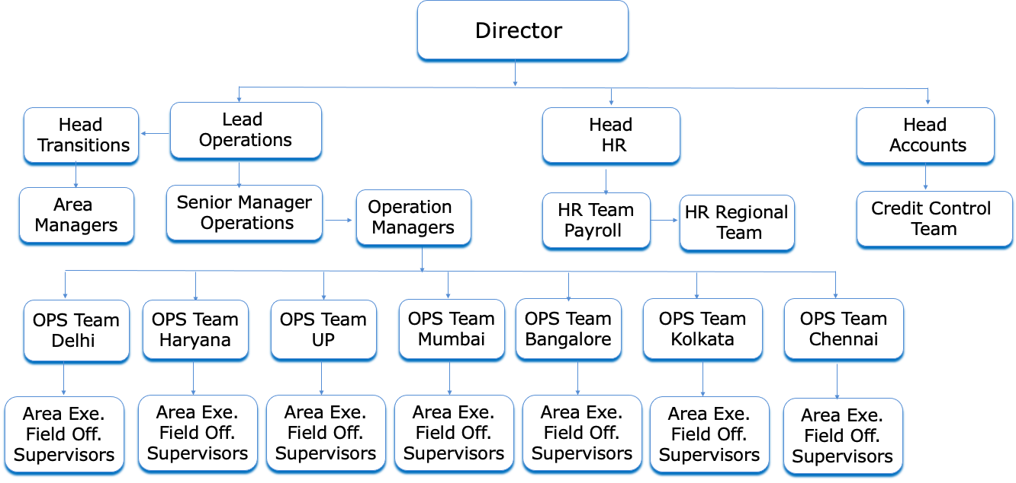
Organization Structure
Collaboration

Slide 19
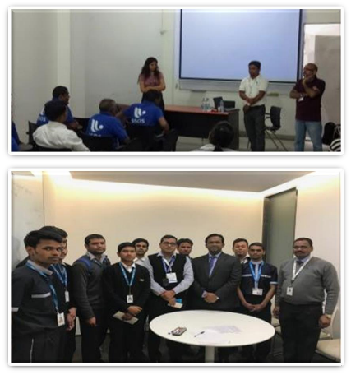
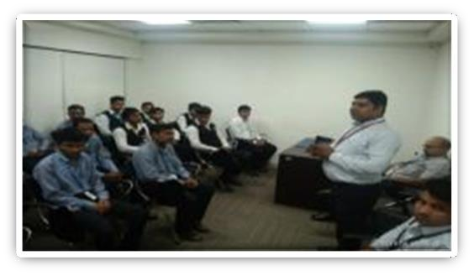
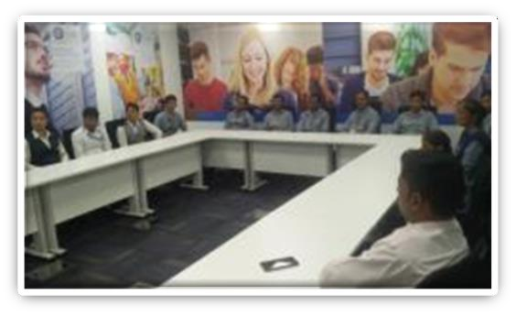
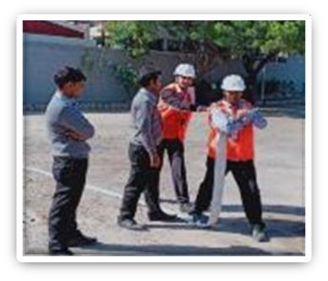
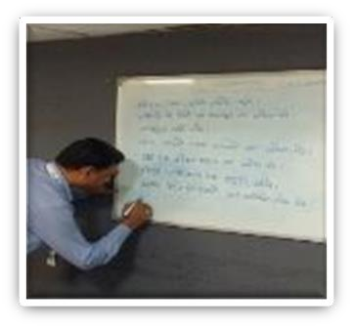
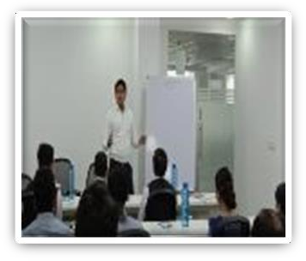

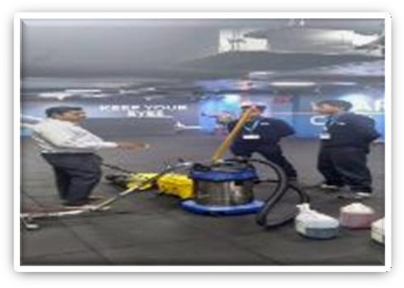
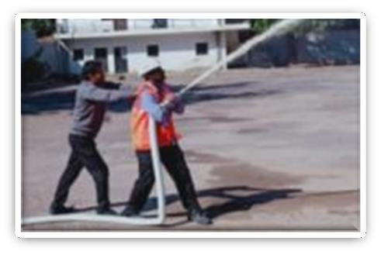
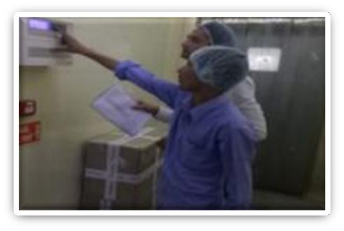
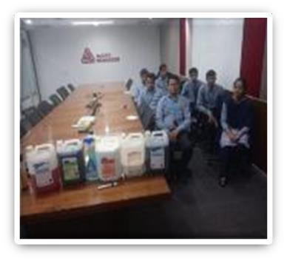
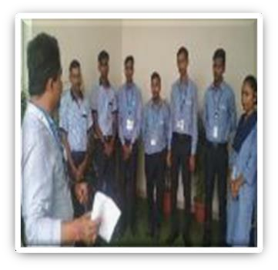
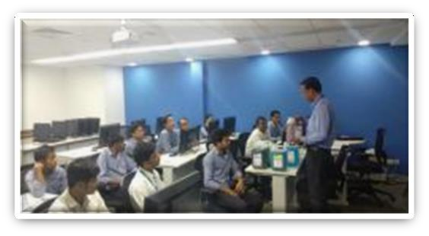
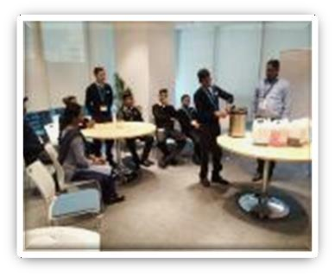
TRAINING

Slide 20
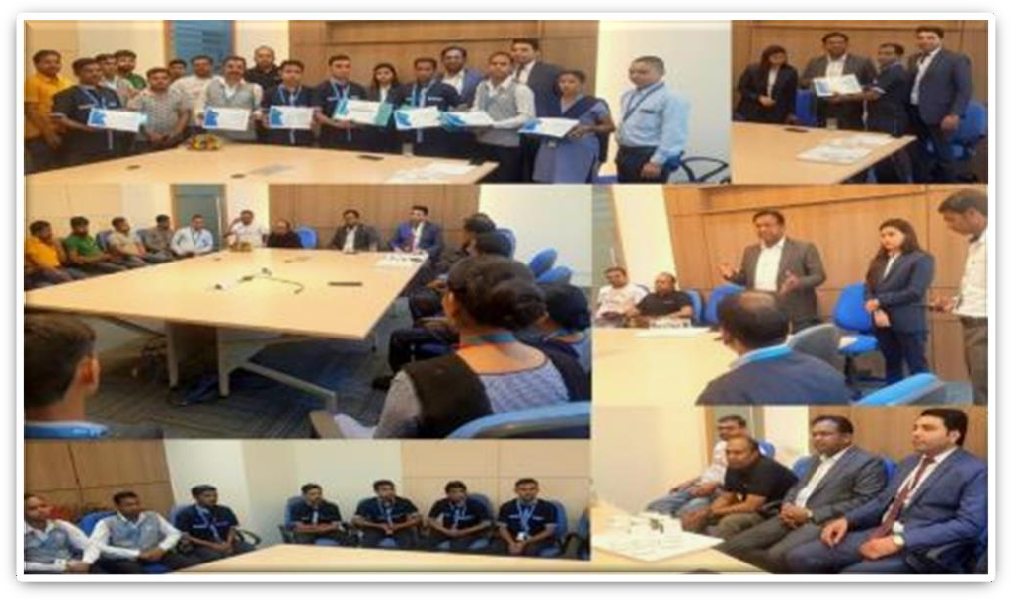
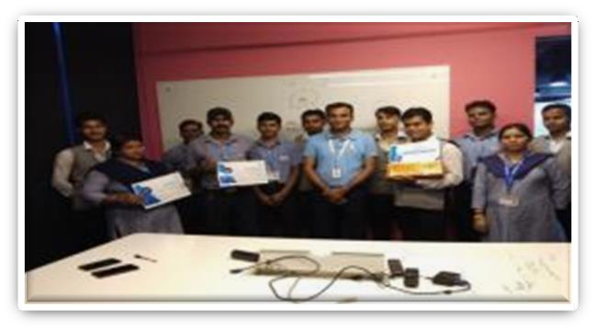
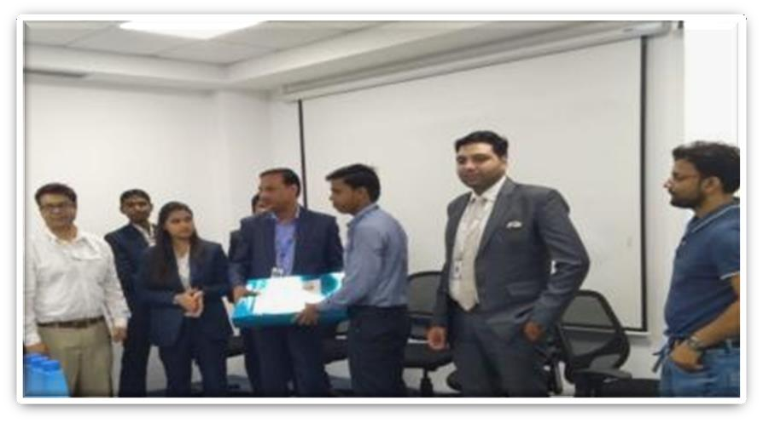
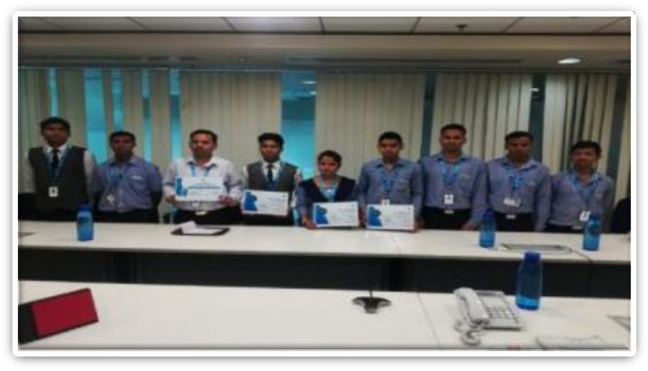
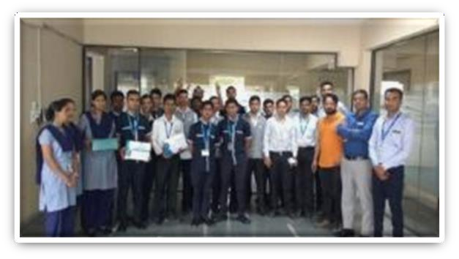
Rewards & Recognition

Slide 21





Statutory Information
EPF No - GN/GGN/0033453/000/0-1/5896
ESIC No - 69000530840001000
PAN NO - AATCS3238G
GST No - 06AATCS3238G1Z3
Quality - ISO 9001-2015 Certified
Legal Consultant - RPL Chavira Group
Auditor - Mohit Goyal & Associates
Banker - Bank of India
Bank Account No - 673620110000222
IFSC Code - BKID0006736

Slide 22


Where We BRING SMILES ☺

Slide 23










HAPPY CUSTOMERS

Slide 24

HAPPY CUSTOMERS

Slide 25

FEW MORE & GROWING…

Slide 26

Our Commitments
"Team SSOS" is diligently working in various industries, from one corner to the other, providing valuable support.
We are dedicated to devising and implementing safe, creative, and eco-friendly solutions throughout your facility while cultivating meaningful and strategic partnerships with your team. The outcome is an outstanding experience for employees, tenants, or guests, characterized by top-notch service quality.
We strive for excellence without compromise.
At "SSOS," our vision is to establish a new benchmark for excellence and nurture the next generation of leaders in the facility services sector.

Slide 27


Contact Us
Davender Arora – Chief Business Officer
Phone : 98114 18637 / +91 92058 88070
Email : davender@ssos.co.in
Address : Plot No 9 – B, 4 Bay, Sector -32,
Gurugram, Haryana – 122 003.
Visit us: www.ssos.co.in

Slide 28


THANK YOU &
We Look Forward To Serve You Soon
Notes:
26

